Slide 1

Environmental Science – (Part II):
Unit 1: Ecosystem, Biodiversity & its Conservation
Unit 2: Environmental Pollution
Unit 3: Environmental Issues, Laws & Ethics

Slide 2
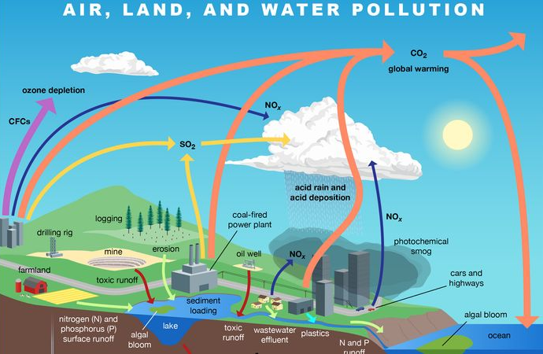
Environmental Science: Pollution
Pollution may be defined as an undesirable change in the physical, chemical or biological characteristics of air, water and land that may be harmful to human life and other animals, living conditions, industrial processes and cultural assets.
Pollution can be natural or manmade.
The agents that pollute are called pollutants.
Pollutants are by-products of man’s action.

Slide 3
Pollutants
The important pollutants are :
• Deposited matter—Soot (a deep black powdery substance consisting largely of amorphous carbon, produced by the incomplete burning of organic matter), smoke, tar or dust and domestic wastes.
• Gases—CO, nitrogen oxides, sulphur oxides, halogens (chlorine, bromine and iodine).
• Metals—Lead, zinc, iron and chromium.
• Industrial pollutants—Benzene, ether, acetic acid and cyanide compounds.
• Agriculture pollutants—Pesticides (Aldrin, dieldrin), herbicides (NaClO₃, Na₃AsO₃), fungicides (cycloheximide, thiabendazole) and fertilizers.
•Photochemical pollutants—Ozone, oxides of nitrogen, aldehydes, ethylene, photochemical smog and peroxy acetyl nitrate.
• Radiation pollutants—Radioactive substances and radioactive fall-outs of the nuclear test.

Slide 4
Classification of Pollutants
On the basis of natural disposal, pollutants are of two types:
(i) Non-degradable pollutants
These are the pollutants, which degrade at a very slow pace by the natural biological processes.
These are inorganic compounds such as salts (chlorides), metallic oxides, waste producing materials and materials like, aluminium cans, mercuric salts and even DDT. These continue to accumulate in the environment.
(ii) Biodegradable pollutants
These include domestic sewage that easily decomposes under natural processes and can be rapidly decomposed by natural/ artificial methods.
These cause serious problems when accumulated in large amounts as the pace of deposition exceeds the pace of decomposition of disposal.

Slide 5
Classification of Pollutants
On the basis of the form in which they persist after their release into the environment, pollutants can be categorized under two types:
(i) Primary pollutants: These include those substances, which are emitted directly from some identifiable sources. This include-
(a) Sulphur compounds: SO2, SO3, H2S produced by the oxidation of fuel.
(b) Carbon compounds: Oxides of carbon (CO+CO2) and hydrocarbons.
(c) Nitrogen compounds: NO2 and NH3.
(d) Halogen compounds: Hydrogen fluoride (HF) and hydrochloric acid (HCl).
(e) Particles of different size and substances: These are found suspended in air. The fine particles below the diameter of 100 µ are more abundant and include particles of metals, carbon, tar, pollen, fungi, bacteria, silicates and others.

Slide 6
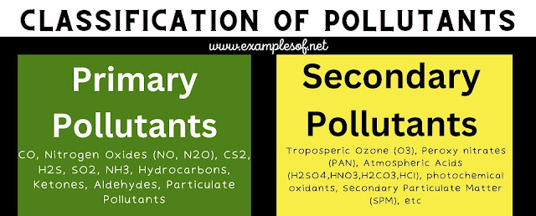
Classification of Pollutants
(ii) Secondary pollutants. The secondary pollutants are produced by the combination of primary emitted pollutants in the atmosphere. In bright sunlight, a photochemical reaction occurs between nitrogen oxides; oxygen and waste hydrocarbons from gasoline that forms peroxy acetyl nitrate (PAN) and ozone (O3), Both of them are toxic components of smog and cause smarting eyes and lung damage.
(iii) Smog. The fog deposited with smoke and chemical fumes forms a dark and thick covering smog. Smog is very common in almost all the industrial areas as the smog is trapped for many days by the stagnant air. It is harmful both for animals and plants.

Slide 7
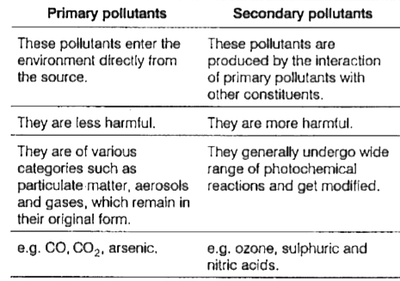

Slide 8
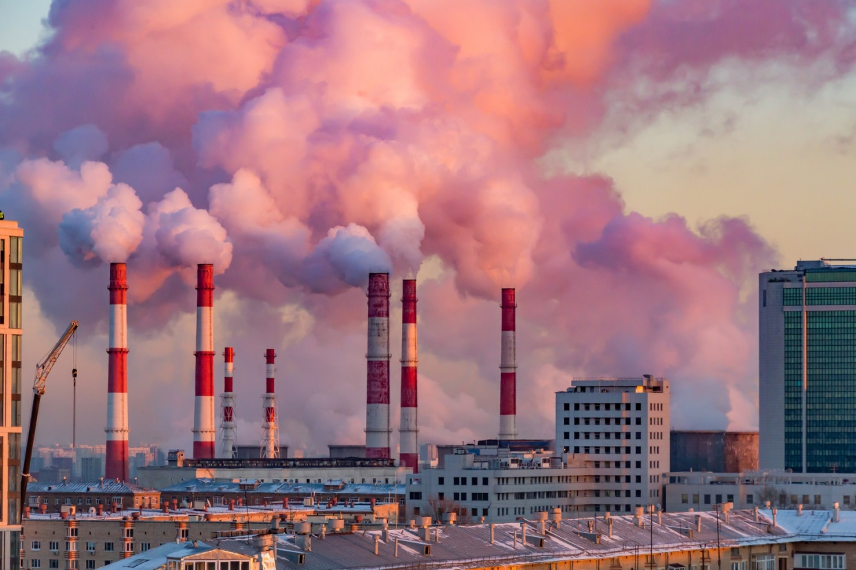
Classification of Pollution
AIR POLLUTION
The WHO defines air pollution as the presence of materials in the air in such concentration which are harmful to man and his environment. A number of ingredients find their way in the air and these are mostly gases, which rapidly spread over wide areas.
SOURCES OF AIR POLLUTION
Various sources of air pollution are fossil fuels, industries, agricultural activities, wars, natural causes and emissions from vehicles.
(i) Burning Fossil Fuels
Burning of wood, charcoal and other fossil fuels causes air pollution by the release of carbon dioxide (CO2), carbon, sulphur dioxide etc. Petroleum consists mainly of hydrocarbons, sulphur and nitrogen.

Slide 9
(ii) Emissions from Automobiles:
Vehicles are mainly responsible for more than 80% of total air pollution.
The major pollutants released from automobiles, locomotives, aircraft etc., include CO, unburnt hydrocarbons and nitrogen oxide.
(iii) Industries
Paper and pulp factories, petroleum refineries, fertilizer plants, and steel industries, thermal power plants are the main sources of air pollution.
They add various harmful gases like CO, SO3, NO, Hydrocarbons etc., to the atmosphere.
Textile factories release cotton dust into the air. Cities experiencing this type of pollution are Kanpur, Surat and Ahmedabad.
The pesticide and insecticide industries are posing serious threat to the environment.
Food processing industries and tanneries emit offensive odors.

Slide 10
Release of poisonous gases from accidents also poses serious threats. e.g. Bhopal Gas Tragedy in which methyl isocynate (MIC) gas leakage killed several people. In Tokyo, about 34 tones of carbon particles mixed with other suspended particles settle per square kilometer every day.
(iv) Agricultural Activities
Spraying of insecticides and weedicides also cause air pollution. These, when inhaled create severe problems to both animals and man.
(v) Wars
Various forms of explosives used in war pollute the air by releasing poisonous gases. This greatly disturbs the ecology of the area. Nuclear explosions pollute air by radioactive rays. The effects of nuclear explosions on Hiroshima and Nagasaki are well-known examples.
(vi) Natural Causes
Gas emissions from active volcanoes, marsh gas, spores of fungi and pollens are the natural causes of air pollution.

Slide 11
COMMON AIR POLLUTANTS
Air pollutants are of two main types ~gaseous and particulate.
Oxides of carbon, nitrogen and sulphur are gaseous pollutants.
Particulate pollutants may be solid or liquid particles, larger particles settle down quickly viz., sand and water droplets whereas small dust particles remain suspended in air for a long time.
These are added into the atmosphere by the processes of blasting, drilling, crushing, grinding and mixing.
(i) Carbon Dioxide
CO2 content of air has increased by 20% during the last century. CO2 causes nausea and headache. It’s increase in the air may cause green house effect, rise in the atmospheric temperature. This may melt the polar ice resulting in rise in level of oceans and flooding of coastal regions.

Slide 12
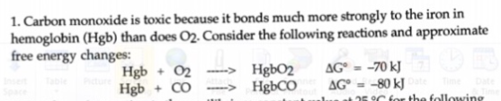
(ii) Carbon Monoxide
It is a very poisonous gas and is produced by incomplete combustion of fuel. If inhaled. it combines with hemoglobin and reduces its oxygen-carrying capacity. This leads to laziness, reduced vision and death.
(iiI) Oxides of Nitrogen
These include NO and NO2, which are released by automobiles and chemical industries as waste gases and also by burning of materials. These are harmful and lower the oxygen carrying capacity of blood.
(iv) Oxides of Sulphur
SO2 and SO3 are produced by burning of coal and petroleum and are harmful to buildings, clothing, plants and animals. High concentration of SO2 causes chlorosis (yellowing of leaves), plasmolysis, damage to mucous membrane and metabolic inhibition. SO2 and SO3 react with water to form Sulphuric and sulphurous acids. These may precipitate as rain or snow producing acid rain or acid precipitation.

Slide 13
(v) Photochemical Oxidants
Formed by the photochemical reactions between primary pollutants, viz. oxides of nitrogen and hydrocarbons. Nitrogen oxides in the presence of sunlight react with unburnt hydrocarbons to form peroxyacyl nitrate (PAN), Ozone, aldehydes and some other complex organic compounds in the air.
(vi) Hydrocarbons.
These are unburnt discharges from incomplete combustion of fuel in automobiles. These form PAN with nitrogen oxides, which is highly toxic.
(vii) Particulate Matter
Industries and automobiles release fine solid and liquid particles into the air. Fly ash and soot from burning of coal, metal dust containing lead, chromium, nickel, cadmium, zinc and mercury from metallurgical processes; cotton dust from textile mills; and pesticides sprayed on crops are examples of particulate pollutants in the air. These are injurious to respiratory tract.

Slide 14
(viii) Aerosols
Aerosols are chemicals released in the air in vapour form. These include fluorocarbon (carbon compound having fluorine) present in emissions from the Jet aeroplanes. Aerosols deplete the ozone layer. Thinning of ozone layer results in more harmful ultraviolet rays reaching the earth, which are harmful to skin, and can lead to skin cancer also.
(ix) Radioactive Substances
These are released by nuclear explosions and explosives. These are extremely harmful for health.
(x) Fluorides
Rocks, soils and. minerals containing fluorides release an extremely toxic gas called hydrogen fluoride on heating. This gas is highly injurious to livestock and cattle.

Slide 15
Fine Particles (PM 2.5)
Fine particulate matter (PM_{2.5}) is an air pollutant that is a concern for people's health when levels in air are high. PM_{2.5} are tiny particles in the air that reduce visibility and cause the air to appear hazy when levels are elevated. Outdoor PM_{2.5} levels are most likely to be elevated on days with little or no wind or air mixing. The New York State Departments of Health (DOH) and Environmental Conservation (DEC) alert the public by issuing a PM_{2.5} Health Advisory when PM_{2.5} concentrations in outdoor air are expected to be unhealthy for sensitive groups.
What is Particulate Matter 2.5 (PM_{2.5})?
The term fine particles, or particulate matter 2.5 (PM_{2.5}), refers to tiny particles or droplets in the air that are two and one half microns or less in width. Like inches, meters and miles, a micron is a unit of measurement for distance. There are about 25,000 microns in an inch. The widths of the larger particles in the PM_{2.5} size range would be about thirty times smaller than that of a human hair. The smaller particles are so small that several thousand of them could fit on the period at the end of this sentence.

Slide 16
How can PM_{2.5} affect my health?
Particles in the PM_{2.5} size range are able to travel deeply into the respiratory tract, reaching the lungs. Exposure to fine particles can cause short-term health effects such as eye, nose, throat and lung irritation, coughing, sneezing, runny nose and shortness of breath. Exposure to fine particles can also affect lung function and worsen medical conditions such as asthma and heart disease. Scientific studies have linked increases in daily PM_{2.5} exposure with increased respiratory and cardiovascular hospital admissions, emergency department visits and deaths. Studies also suggest that long term exposure to fine particulate matter may be associated with increased rates of chronic bronchitis, reduced lung function and increased mortality from lung cancer and heart disease. People with breathing and heart problems, children and the elderly may be particularly sensitive to PM_{2.5}.

Slide 17
Where does PM_{2.5} come from?
There are outdoor and indoor sources of fine particles. Outside, fine particles primarily come from car, truck, bus and off-road vehicle (e.g., construction equipment, snowmobile, locomotive) exhausts, other operations that involve the burning of fuels such as wood, heating oil or coal and natural sources such as forest and grass fires. Fine particles also form from the reaction of gases or droplets in the atmosphere from sources such as power plants. These chemical reactions can occur miles from the original source of the emissions. In New York State, some of the fine particles measured in the air are carried by wind from out-of-state sources. Because fine particles can be carried long distances from their source, events such as wildfires or volcanic eruptions can raise fine particle concentrations hundreds of miles from the event.
PM_{2.5} is also produced by common indoor activities. Some indoor sources of fine particles are tobacco smoke, cooking (e.g., frying, sautéing, and broiling), burning candles or oil lamps, and operating fireplaces and fuel-burning space heaters (e.g., kerosene heaters).

Slide 18
Is there an air quality standard for PM_{2.5} in outdoor air?
Yes, the United States Environmental Protection Agency (EPA) established National Ambient Air Quality Standards for PM_{2.5} in 1997 and revised them in 2006 and 2012. National Ambient Air Standards are established to be protective of public health. The short-term standard (24-hour or daily average) is 35 micrograms per cubic meter of air (µg/m³) and the long-term standard (annual average) is 12 µg/m³. A microgram is a unit of weight. There are a million micrograms in a gram, and a pound is equal to about 450 grams.
How will I know when PM_{2.5} levels are, or will be, elevated outside?
Outdoor air levels of fine particles increase during periods of stagnant air (very little wind and air mixing), when the particles are not carried away by wind, or when winds bring polluted air into the state from sources outside the state. In general, as the levels of PM_{2.5} in outdoor air increase, the air appears hazy and visibility is reduced. These conditions are similar in appearance to high humidity or fog.

Slide 19
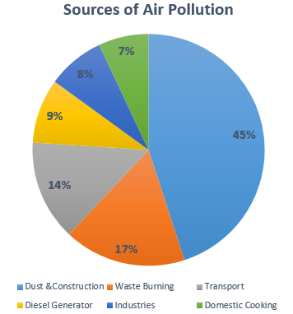
POLLUTION IN INDIA
India supports a large network of factories and industries.
These factories are generally localized in eight or ten large industrial centres.
These are also a great source of air as well water pollution.
To be on a safer side delocalisation of industries is the need of the time.
This would lead to an even distribution of pollutants and faster degeneration of pollutants.
Dust & Construction contribute about 59% to the air pollution in India, which is followed by Waste Burning. Crafting activities are mostly in the urban areas while Waste Burning is in the rural areas (agriculture).

Slide 20
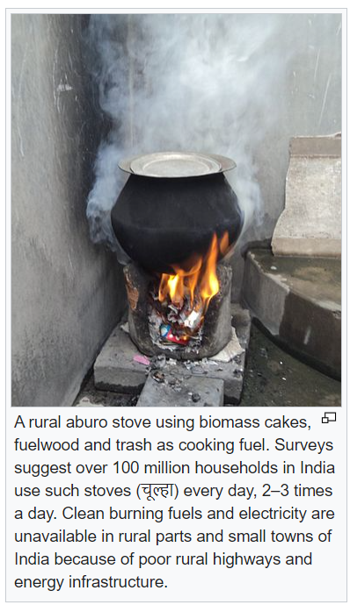
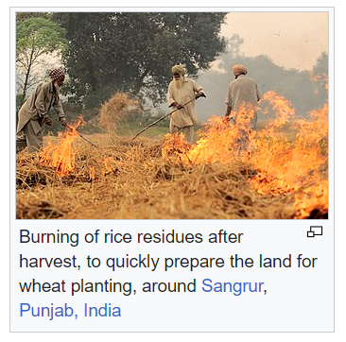
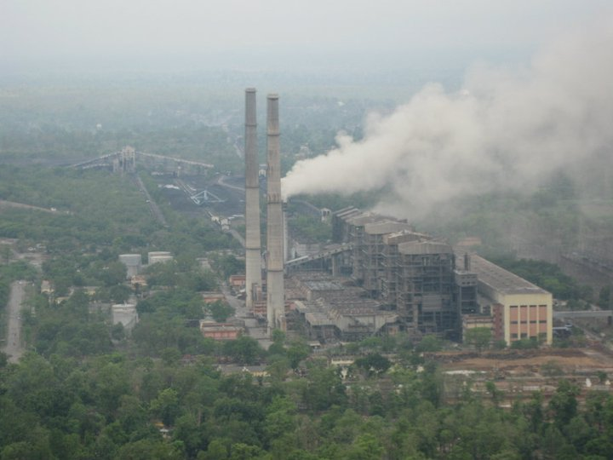
Coal-fired power station

Slide 21
The major pollutants coming out from these industries are -
(i) Industrial Pollutants. The common air pollutants from industries are SO2, CO, CO2, H2S and hydrocarbons together with dust, smoke and grit. These are produced by the burning of coal and petroleum and by the combustion of lignite at thermal power stations. The chemical industries release HCl, chlorine, nitrogen oxide and oxides of copper, zinc, lead and arsenic.
The fertilizer factories at Gorakhpur and Ahmedabad; the steel industries at Bhilai, Rourkela, Jamshedpur and Durgapur pollute the air with above-said gases.
(ii) Automobile Exhausts. Automobiles run by petrol and diesel produce CO, nitrogen oxides and hydrocarbons. Hundreds and thousands tons of hydrocarbons and CO are emitted into air daily. Metropolitan cities harbour lakhs and crores of automobiles. Every gallon of petrol consumed by automobiles produces 3 pounds of carbon monoxide and 15 pounds. of nitrogen oxide.
(iii) Ionizing Radiations from Radioactive Substances. Ionizing radiations include alpha, beta particles and the gamma rays etc. These are produced by atomic explosions and testing of atomic weapons.

Slide 22
Effects of Air Pollution
Effect on Plants
(i) SO2 causes chlorosis and also results in the death of cells and tissues.
(ii) Fluorides and PAN damage leafy vegetables such as lettuce and spinach.
(iii) Oxides of nitrogen and fluorides reduce crop yield.
(iv) Smog bleaches and blaze foliage of important leafy plants.
(v) Hydrocarbons cause premature yellowing, fall of leave and flower buds, discoloration and curling of sepals and petals.
(vi) Smoke and dust cover the leaf surface and reduce photosynthetic capacity of plants.
(vii) Ozone damages cereals, fruits, and cotton crop.

Slide 23
Effect on Human
The effect of pollutants on animals and human are
(i) Ozone causes dryness of mucous membranes, changes eye vision, causes headache, pulmonary congestion and oedema.
(ii) Ozone has been reported to produce chromosomal aberrations.
(iii) SO2 causes drying of mouth, scratchy throat, smarting eyes and disorders of respiratory tract.
(iv) SO3, CO and NO2 diffuse into blood stream and reduce oxygen transport. CO damages cardiovascular system. Hydrocarbons and other pollutants act, as carcinogens and lead to different cancers.
(v) Cotton dust leads to respiratory disorders e.g. bronchitis and asthma.
(vi) Smoking of tobacco causes cancerous growth in lungs.

Slide 24
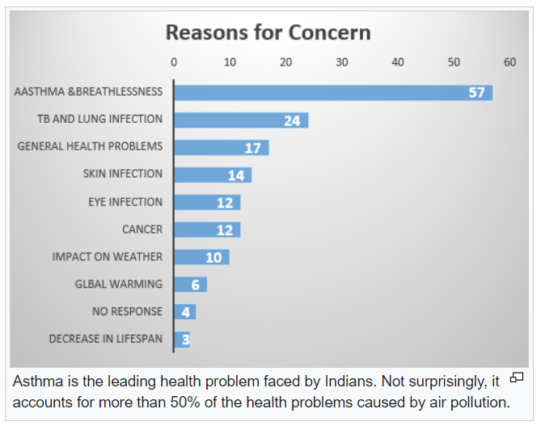
Effects of Air Pollution in India on Humans

Slide 25
Change in Climate
CO2 content of air is increasing due to deforestation and combustion of fuel.
This increase is affecting the composition and balance of gases in the atmosphere. Increase in CO2 concentration may increase the atmospheric temperature, producing green house effect A rise of global temperature by more than 2-3 degrees may melt glaciers and polar ice. This would lead to a rise in ocean level and consequent flooding and submergence of coastal areas.
Rainfall pattern may also change, affecting agricultural output in various regions of’ the world.
Aerosols deplete the ozone layer in the stratosphere. Thinning of ozone layer would permit more of the harmful ultraviolet rays to reach the earth. This may cause, sunburn, blindness and inactivation of proteins, RNA, DNA and plant pigments.
Aesthetic Loss
Dust and smoke spoils the beauty of nature. Especially the mountain environments, which serve as a great attraction for tourists. Foul odours emitted by industries, automobiles, dirty drains and garbage heaps in cities are a great nuisance.

Slide 26
PHOTO CHEMICAL SMOG
Photochemical smog was first described in the 1950s.
It is the chemical reaction of sunlight, nitrogen oxides and volatile organic compounds in the atmosphere, which leaves airborne particles and ground-level ozone.
This noxious mixture of air pollutants can includes Aldehydes, Nitrogen oxides, such as nitrogen dioxide, Peroxyacyl nitrates Tropospheric ozone, Volatile organic compounds etc.
All of these chemicals are usually highly reactive and oxidizing.
Photochemical smog is considered to be a problem of modern industrialization. It is present in all modern cities, but it is more common in cities with sunny, warm, dry climates and a large number of motor vehicles. Because it travels with the wind, it can affect sparsely populated areas as well. VOCs + NOx + sunlight → photochemical smog

Slide 27
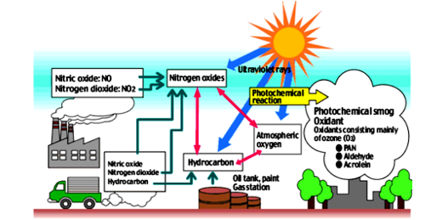
To begin the chemical process of photochemical smog development the following conditions must occur: • Sunlight. • The production of oxides of nitrogen (NOx). • The production of volatile organic compounds (VOCs). • Temperatures greater than 18 degrees Celsius.
Nitrogen oxide is an essential ingredient of photochemical smog that is produced during the high temperatures associated with combustion of vehicle’s engines

Slide 28
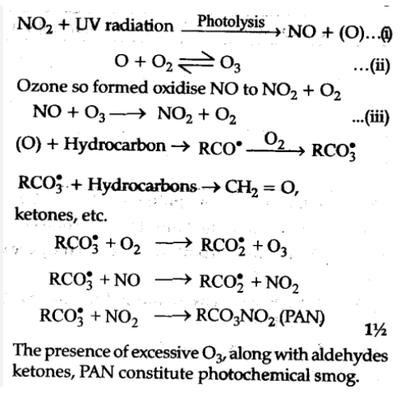
Formation
Sunlight can break down nitrogen dioxide back into nitrogen oxide. NO₂ + sunlight »»» NO + O The atomic oxygen formed in the above reaction then reacts with one of the abundant oxygen molecules producing ozone. O + O₂ »»» O₃ Nitrogen dioxide can also react with radicals produced from volatile organic compounds in a series of reactions to form toxic products such as peroxyaceyl nitrates. NO₂ + R »»» products such as PAN Note the symbol R represents a hydrocarbon (a molecule composed of carbon, hydrogen and other atoms) which is primarily created from volatile organic compounds.
Steps 1) Nitrogen oxides generate oxygen atoms 2) Oxygen atoms form hydroxyl radicals 3) Hydroxyl radicals generate hydrocarbon radicals 4) Hydrocarbon radicals form hydrocarbon peroxides 5) Hydrocarbon peroxides formaldehydes
6) Aldehydes form aldehyde peroxides 7) Aldehyde peroxides form peroxyacylnitrates
Health effects It can cause eye and nose irritation and it dries out the protective membranes of the nose and throat and interferes with the body's ability to fight infection, increasing susceptibility to illness.

Slide 29
ACID MIST/ RAIN Normal Rain water pH is slightly acidic due to certain concentration of CO2 dissolved as rainwater trickles down atmosphere, CO2+H2O→HCO₃⁻+H⁺
Acid rain is defined as any type of precipitation with a pH that is unusually low or lower than 5.7.
Acid rain was first found in Manchester, England.
In 1852, Robert Angus Smith found the relationship between acid rain and atmospheric pollution.
Though acid rain was discovered in 1852, it wasn't until the late 1960s that scientists began widely observing and studying the phenomenon.
When fossil fuels such as coal, oil and natural gas are burned, chemicals like sulfur dioxide and nitrogen oxides are produced. These chemicals react with water and other chemicals in the air to form sulfuric acid, nitric acid and other harmful pollutants like sulfates and nitrates. These acid pollutants spread upwards into the atmosphere, and are carried by air currents, to finally return to the ground in the form of acid rain, fog or snow. This is called acid deposition.

Slide 30
Causes of Acid Rain
The principal natural phenomena that contribute acid-producing gases to the atmosphere are emissions from volcanoes and those from biological processes that occur on the land, in wetlands, and in the oceans. The major biological source of sulfur containing compounds is dimethylsulfide.
The principal cause of acid rain is sulfuric and nitrogen compounds from human sources, such as electricity generation, factories and motor vehicles. Coal power plants are one of the most polluting. The gases can be carried hundreds of kilometres in the atmosphere before they are converted to acids and deposited.
Factories used to have short funnels to let out smoke, but this caused many problems, so now, factories have longer smoke funnels. The problem with this is those pollutants get carried far off, where it creates more destruction.
Sulfur dioxide contributes to about seventy percent of acid rain while nitrogen oxides provide the remaining thirty percent. The sources of sulfur in the atmosphere include coal combustion, smelting, organic decay, and ocean spray. Approximately ninety percent of atmospheric sulfur results from human activities.

Slide 31
In the atmosphere, sulfur dioxide combines with water vapor to form hydrogen sulfite gas: SO2 + H2O+1/2O2 → H2SO4 Next, hydrogen sulfite reacts with oxygen to form sulfuric acid, a major component of acid rain: H2SO3 + 1/2O2 → H2SO4
The sources of nitrogen oxides include the combustion of oil, coal and natural gas, forest fires, bacterial action in soil, volcanic gases, and lighting-induced atmospheric reactions. In the atmosphere, nitrogen monoxide reacts with oxygen gas to form nitrogen dioxide gas: NO + 1/2O2 → NO2 Then, nitrogen dioxide reacts with water vapor in the atmosphere to form hydrogen nitrite and hydrogen nitrate: 2NO2 + H2O → HNO2 + HNO3 Henceforth, acid rain is a mixture of HNO3, H2SO4 + HCl. however conditions needed to favor formation of these are sunlight, temperature, humidity, hydrocarbons, NOX, SO2.

Slide 32
Effects of Acid Rain
Effects of Acid Rain:
Acid rain is known to cause widespread environmental damage.
1. Acid rain dissolves and washes away nutrients in the soil which are needed by plants. It can also dissolve naturally occurring toxic substances like aluminium and mercury, freeing them to pollute water or poison plants. Both the lower pH and higher aluminum concentrations in surface water can cause damage to fish and other aquatic animals. At pH lower than 5 most fish eggs will not hatch and lower pH can kill adult fish. As lakes become more acidic biodiversity is reduced. Soil biology can be seriously damaged by acid rain. Some tropical microbes can quickly consume acids but other microbes are unable to tolerate low pH and are killed.
2. Acid rain indirectly affects plants by removing nutrients from the soil in which they grow. It affects trees more directly by creating holes in the waxy coating of leaves, causing brown dead spots which affect the plant’s photosynthesis. Such trees are also more vulnerable to insect infestations, drought and cold. Spruce and fir forests at higher elevations seem to be most at risk. Acid rain can slow the growth of forests, cause leaves and needles to turn brown and fall off and die. In extreme cases trees or whole areas of forest can die. The death of trees is not usually a direct result of acid rain; often it weakens trees and makes them more susceptible to other threats. Farm crops are less affected by acid rain than forests.

Slide 33
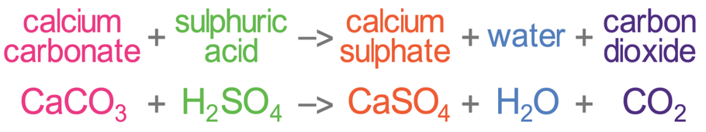
3. Acid rain and dry acid deposition damages buildings, automobiles, and other structures made of stone or metal. The acid corrodes the materials causing extensive damage and ruins historic buildings. Limestone structures are especially susceptible because they dissolve easily in acidic solutions. For instance the Parthenon in Greece and the Taj Mahal in India have been affected by acid rain. This is because the sulfuric acid in the rain chemically reacts with the calcium compounds in the stones (limestone, sandstone, marble and granite) to create gypsum, which then flakes off. Acid rain also causes an increased rate of oxidation for iron.
4. Acid rain also has far reaching effects on wildlife. By adversely affecting one species, the entire food chain is disrupted, ultimately endangering the entire ecosystem. Different aquatic species can tolerate different levels of acidity. For instance clams and mayflies have a high mortality when water has a pH of 6.0, while frogs can tolerate more acidic water, although with the decline in supply of mayflies, frog populations may also decline. Land animals that are dependent on aquatic organisms are also affected.
5. Although surface water polluted by acid rain does not directly harm people, the toxic substances leached from soil can pollute water supply. Fish caught in these waters may be harmful for human consumption. Acid, along with other chemicals in the air, produces urban smog, which causes respiratory problems.

Slide 34
Control
Design more efficient automobile engines in order to reduce nitrogen oxide emissions.
Increase efficiency of power plants that burn coal in order to reduce waste that contains sulfur dioxide and nitrogen oxide.
Increase penalties on industries that do not meet air pollution guidelines Increase tax incentives to industries that do meet guidelines.
Use alternative energy sources, Increase funding for alternative energy sources; for example, give tax incentives to buyers of hybrid cars.
Provide tax incentives to companies that use alternative energy sources.
Add CaCO3 (calcium carbonate) to lakes suffering from acid deposition; calcium carbonate acts as a buffer, resisting a change in pH and lessening the negative effects of acid rain.

Slide 35
OZONE DEPLETION
Ozone layer is an umbrella 24 km [15 miles] from earth surface, an essential component of the stratosphere that absorbs short wavelength ultraviolet radiation from the sun, heating the gases of the stratosphere in the process.
World ozone day is celebrated on Sept, 16 of every year.
Stratospheric ozone is measured in Dobson units [DU] named after G.M.B Dobson who pioneered the study; [I Dobson unit = 0.01 mm thickness of stratospheric ozone], Average ozone thickness in stratosphere is 300 DU, & when it falls below 200 DU, it’s considered as Ozone hole. It is thinnest around equator and thickest near poles.
Stratospheric ozone depletion is the term applied to the loss of stratospheric ozone molecules (O3) and the disruption of Oxygen-Ozone concentration equilibrium in stratosphere [i.e., when chlorine atoms upset the natural O2/O3 equilibrium in the stratosphere]. Oxygen molecules interact with the intense solar radiation present at this elevation to form oxygen atoms. The oxygen atoms thus generated react with other oxygen molecules to form ozone (O3).

Slide 36
Causes
Ozone depletion is caused by the release of chlorofluorocarbons (CFC's) and other ozone-depleting substances (ODS), which were used widely as refrigerants, insulating foams, and solvents.
Although CFCs are heavier than air, they are eventually carried into the stratosphere in a process that can take as long as 2 to 5 years. When CFCs reach the stratosphere, the ultraviolet radiation from the sun causes them to break apart and release chlorine atoms which react with ozone, starting chemical cycles of ozone destruction that deplete the ozone layer. One chlorine atom can break apart more than 100,000 ozonemolecules.
Other chemicals that damage the ozone layer include methyl bromide (used as a pesticide), halons (used in fire extinguishers), and methyl chloroform (used as a solvent in industrial processes).

Slide 37
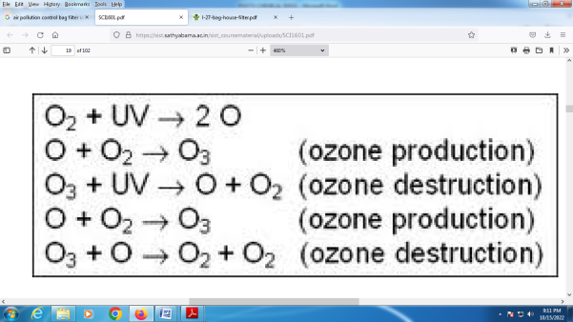
As methyl bromide and halons are broken apart, they release bromine atoms, which are 40 times more destructive to ozone molecules than chlorine atoms.
Chapman’s Reaction
Ozone Depletion by CFC’s

Slide 38
Effects
Effect of ozone hole include cataract, genetic mutation, constriction of blood vessels, reduced crop yield, leukemia, breast cancer, damage to crop, aqua culture,etc.,
The higher energy UV radiation absorbed by ozone is generally accepted to be a contributory factor to skin cancer.
In addition, increased surface UV leads to increased tropospheric ozone, which is a health risk to humans such as Snow Blindness [photo keratosis], i.e., inflammation of cornea (outer coating of eyeball). The most common forms of skin cancer in humans, basal and squamous cell carcinomas have been strongly linked to UVB exposure. Another form of skin cancer, malignant melanoma, is much less common but far more dangerous, being lethal in about 15% - 20% of the cases diagnosed.
In India there is no standard for Ozone. However WHO standard is 100 ppm for 8 hrs. – avg

Slide 39
Control Measures
The Montreal Protocol, an international agreement signed by 139 nations, banning the production of CFCs by the year 2000.
We can't make enough ozone to replace what's been destroyed, but provided that we stop producing ozone-depleting substances, natural ozone production reactions should return the ozone layer to normal levels by about 2050.
It is very important that the world comply with the Montreal Protocol; delays in ending production could result in additional damage and prolong the ozone layer's recovery.
Control mechanism stresses on replacement of the banned chemical by ammonia, steam, helium etc.

Slide 40
THE GREENHOUSE EFFECT
The Sun powers Earth’s climate, radiating energy at very short wavelengths, predominately in the visible or near-visible (ultraviolet) part of the spectrum. About one- third of the solar energy that reaches the top of Earth’s atmosphere is reflected directly back to space. The remaining two- thirds is absorbed by the surface and by the atmosphere. To balance the absorbed incoming energy, the Earth must, on average, radiate the same amount of energy back to space. Because the Earth is much colder than the Sun, it radiates at much longer wavelengths, primarily in the infrared part of the spectrum. Much of this thermal radiation, emitted by the land and ocean, is absorbed by the atmosphere, and reradiated back to Earth. This is called the greenhouse effect.
The glass walls in a greenhouse reduce airflow and increase the temperature of the air inside. Similarly, but through a different physical process, the Earth’s greenhouse effect warms the surface of the planet. Without the natural greenhouse effect, the average temperature at Earth’s surface would be below the freezing point of water. Thus, Earth’s natural greenhouse effect makes life as we know it possible.
However, human activities, primarily the burning of fossil fuels and clearing of forests, have greatly intensified the natural greenhouse effect, causing global warming.

Slide 41
Greenhouse Gases
Many greenhouse gases occur naturally in the environment, such as water vapor, carbon dioxide, methane, nitrous oxide, and ozone. Others such as hydrofluorocarbons (HFCs), perfluorocarbons (PFCs), and sulfur hexafluoride (SF6) are created and emitted solely through human activities. Human activities also add significantly to the level of naturally occurring greenhouse gases. The principal greenhouse gases that enter the atmosphere because of human activities are: • Carbon Dioxide (CO₂): Carbon dioxide enters the atmosphere through the burning of fossil fuels (oil, natural gas, and coal), solid waste, trees and wood products, and also as a result of other chemical reactions (e.g., manufacture of cement). Carbon dioxide is also removed from the atmosphere (or "sequestered") when it is absorbed by plants as part of the biological carbon cycle. • Nitrous Oxide (N₂O): Nitrous oxide is emitted during various agricultural and industrial activities, as well as during combustion of fossil fuels and solid waste.

Slide 42
• Methane (CH₄): Methane is emitted during the production and transport of coal, natural gas, and oil. Methane is also emitted when organic waste decomposes, whether in landfills or in connection with livestock farming.
• Fluorinated Gases: Hydrofluorocarbons, perfluorocarbons, and sulfur hexafluoride are synthetic, powerful greenhouse gases that are emitted from a variety of industrial processes. Fluorinated gases are sometimes used as substitutes for ozone-depleting substances (i.e., CFCs, HCFCs, and halons).
These gases are typically emitted in smaller quantities, but because they are potent greenhouse gases, they are sometimes referred to as High Global Warming Potential gases ("High GWP gases").
Greenhouse gases vary in their ability to absorb and hold heat in the atmosphere. HFCs and PFCs are the most heat-absorbent, but there are also wide differences between naturally occurring gases. For example, nitrous oxide absorbs 270 times more heat per molecule than carbon dioxide, and methane absorbs 21 times more heat per molecule than carbon dioxide. However, carbon dioxide contributes the most, since its level in the atmosphere is the highest.

Slide 43
The Effects of Global Warming
With more heat trapped on Earth, the planet will become warmer, which means the weather all over Earth will change. Since the conditions we are living in are perfect for life, a large rise in temperature could be disastrous for us and for any other living creatures on Earth. At the moment, it is difficult for scientists to say how big the changes will be and where the worst effects will occur. These are some of the assumptions.
The Weather The effects will vary in different parts of the world: some places will become drier and others will become wetter. Although most areas will be warmer, some areas will become cooler. There may be many storms, floods and drought, but we do not know which areas of the world will be affected. All over the world, these weather changes will affect the kinds of crop that can be grown. Plants, animals, and even people may find it difficult to survive in different conditions.

Slide 44
Sea Levels
Higher temperatures will make the water of the seas and oceans expand. Ice melting in the Antarctic and Greenland will flow into the sea. All over the world, sea levels may rise, perhaps by as much as 20 to 40 cm, by the beginning of the next century. Higher sea levels will threaten the low-lying coastal areas of the world, such as the Netherlands and Bangladesh. Throughout the world, millions of people and areas of land will be at danger from flooding. Many people will have to leave their homes and large areas of farmland will be ruined because of floods.
Farming
The changes in the weather will affect the types of crops grown in different parts of the world. Some crops, such as wheat and rice, grow better in higher temperatures, but other plants, such as maize and sugarcane, do not. Changes in the amount of rainfall will also affect how many plants grow. The effect of a change in the weather on plant growth may lead to some countries not having enough food. Brazil, parts of Africa, south-east Asia, and China will be affected the most and many people could suffer from hunger.

Slide 45
Plants & Animals
It has taken millions of years for life to become used to the conditions on Earth. As weather and temperature changes, the homes of plants and animals will be affected all over the world. For example, polar bears and seals will have to find new land for hunting and living if the ice in the Arctic melts. Many animals and plants may not be able to cope with these changes and could die. This could cause the loss of some animal and plant species in certain or all areas of the world.
People The changes in climate will affect everyone, but some populations will be at greater risk. For example, countries whose coastal regions have a large population, such as Egypt and China, may see whole populations move inland to avoid flood risk areas. The effect on people will depend on how well we can adapt to the changes and how much we can do to reduce climate change in the world.

Slide 46
Causes of Climate Change
Generating power
Generating electricity and heat by burning fossil fuels causes a large chunk of global emissions. Most electricity is still generated by burning coal, oil, or gas, which produces carbon dioxide and nitrous oxide – powerful greenhouse gases that blanket the Earth and trap the sun’s heat. Globally, a bit more than a quarter of electricity comes from wind, solar and other renewable sources which, as opposed to fossil fuels, emit little to no greenhouse gases or pollutants into the air.
Manufacturing goods
Manufacturing and industry produce emissions, mostly from burning fossil fuels to produce energy for making things like cement, iron, steel, electronics, plastics, clothes, and other goods. Mining and other industrial processes also release gases, as does the construction industry. Machines used in the manufacturing process often run on coal, oil, or gas; and some materials, like plastics, are made from chemicals sourced from fossil fuels. The manufacturing industry is one of the largest contributors to greenhouse gas emissions worldwide.

Slide 47
Cutting down forests
Cutting down forests to create farms or pastures, or for other reasons, causes emissions, since trees, when they are cut, release the carbon they have been storing. Each year approximately 12 million hectares of forest are destroyed. Since forests absorb carbon dioxide, destroying them also limits nature’s ability to keep emissions out of the atmosphere. Deforestation, together with agriculture and other land use changes, is responsible for roughly a quarter of global greenhouse gas emissions.
Using transportation
Most cars, trucks, ships, and planes run on fossil fuels. That makes transportation a major contributor of greenhouse gases, especially carbon-dioxide emissions. Road vehicles account for the largest part, due to the combustion of petroleum-based products, like gasoline, in internal combustion engines. But emissions from ships and planes continue to grow. Transport accounts for nearly one quarter of global energy-related carbon-dioxide emissions. And trends point to a significant increase in energy use for transport over the coming years.

Slide 48
Producing food
Producing food causes emissions of carbon dioxide, methane, and other greenhouse gases in various ways, including through deforestation and clearing of land for agriculture and grazing, digestion by cows and sheep, the production and use of fertilizers and manure for growing crops, and the use of energy to run farm equipment or fishing boats, usually with fossil fuels. All this makes food production a major contributor to climate change. And greenhouse gas emissions also come from packaging and distributing food.
Powering buildings
Globally, residential and commercial buildings consume over half of all electricity. As they continue to draw on coal, oil, and natural gas for heating and cooling, they emit significant quantities of greenhouse gas emissions. Growing energy demand for heating and cooling, with rising air-conditioner ownership, as well as increased electricity consumption for lighting, appliances, and connected devices, has contributed to a rise in energy-related carbon-dioxide emissions from buildings in recent years.

Slide 49
Effects of Climate Change
Hotter temperatures
As greenhouse gas concentrations rise, so does the global surface temperature. The last decade, 2011-2020, is the warmest on record. Since the 1980s, each decade has been warmer than the previous one. Nearly all land areas are seeing more hot days and heat waves. Higher temperatures increase heat-related illnesses and make working outdoors more difficult. Wildfires start more easily and spread more rapidly when conditions are hotter. Temperatures in the Arctic have warmed at least twice as fast as the global average.
More severe storms
Destructive storms have become more intense and more frequent in many regions. As temperatures rise, more moisture evaporates, which exacerbates extreme rainfall and flooding, causing more destructive storms. The frequency and extent of tropical storms is also affected by the warming ocean. Cyclones, hurricanes, and typhoons feed on warm waters at the ocean surface. Such storms often destroy homes and communities, causing deaths and huge economic losses.

Slide 50
Increased drought
Climate change is changing water availability, making it scarcer in more regions. Global warming exacerbates water shortages in already water-stressed regions and is leading to an increased risk of agricultural droughts affecting crops, and ecological droughts increasing the vulnerability of ecosystems. Droughts can also stir destructive sand and dust storms that can move billions of tons of sand across continents. Deserts are expanding, reducing land for growing food. Many people now face the threat of not having enough water on a regular basis.
A warming, rising ocean
The ocean soaks up most of the heat from global warming. The rate at which the ocean is warming strongly increased over the past two decades, across all depths of the ocean. As the ocean warms, its volume increases since water expands as it gets warmer. Melting ice sheets also cause sea levels to rise, threatening coastal and island communities. In addition, the ocean absorbs carbon dioxide, keeping it from the atmosphere. But more carbon dioxide makes the ocean more acidic, which endangers marine life and coral reefs.

Slide 51
Loss of species
Climate change poses risks to the survival of species on land and in the ocean. These risks increase as temperatures climb. Exacerbated by climate change, the world is losing species at a rate 1,000 times greater than at any other time in recorded human history. One million species are at risk of becoming extinct within the next few decades. Forest fires, extreme weather, and invasive pests and diseases are among many threats related to climate change. Some species will be able to relocate and survive, but others will not.
Not enough food
Changes in the climate and increases in extreme weather events are among the reasons behind a global rise in hunger and poor nutrition. Fisheries, crops, and livestock may be destroyed or become less productive. With the ocean becoming more acidic, marine resources that feed billions of people are at risk. Changes in snow and ice cover in many Arctic regions have disrupted food supplies from herding, hunting, and fishing. Heat stress can diminish water and grasslands for grazing, causing declining crop yields and affecting livestock.

Slide 52
More health risks
Climate change is the single biggest health threat facing humanity. Climate impacts are already harming health, through air pollution, disease, extreme weather events, forced displacement, pressures on mental health, and increased hunger and poor nutrition in places where people cannot grow or find sufficient food. Every year, environmental factors take the lives of around 13 million people. Changing weather patterns are expanding diseases, and extreme weather events increase deaths and make it difficult for health care systems to keep up.
Poverty and displacement
Climate change increases the factors that put and keep people in poverty. Floods may sweep away urban slums, destroying homes and livelihoods. Heat can make it difficult to work in outdoor jobs. Water scarcity may affect crops. Over the past decade (2010–2019), weather-related events displaced an estimated 23.1 million people on average each year, leaving many more vulnerable to poverty. Most refugees come from countries that are most vulnerable and least ready to adapt to the impacts of climate change.

Slide 53
Control of Air Pollution
Following measures have been suggested to control air pollution-
(i) Some gases, which are more soluble in a particular liquid than air, for example, ammonia in water, can be separated by dissolving in it
(ii) Particles larger than 50 mm are separated in gravity settling tanks. Using cyclone collectors or electrostatic precipitators separates fine particles.
(iii) The height of chimneys should .be increased to the highest possible level to reduce pollution at the ground level.
(iv) SO2 pollution can be controlled by extracting sulphur from the fuel before use.
(v) Pollution control laws should be enforced strictly.
(vi) Trees should be planted on the roadside, riverbanks, parks and’ open places as they keep the environment fresh.
(vii) Population growth, which is the main cause of pollution should be checked.
(viii) Nuclear explosions should be restricted.

Slide 54
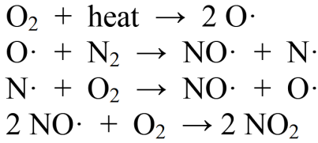
CATALYTIC CONVERTERS
Automobile engines convert the energy stored in chemical bonds into mechanical energy through the controlled combustion of gasoline (hydrocarbons, C x H y) in air: C xH y + O2 → CO2 + H2 O + heat When there is the correct balance of O2 and hydrocarbons in the combustion chamber (i.e., under “lean” conditions), complete combustion occurs and CO2 and H2 O are emitted in the exhaust. When the mixture is not in balance, such as the case when there is too much fuel and not enough oxygen (i.e., under “rich” conditions), combustion is incomplete and the exhaust can contain CO and excess hydrocarbons. Since both nitrogen and oxygen are present in air used for combustion, the following reactions may also take place within the engine, especially when the combustion temperature is high:

Slide 55
As a result, nitrogen oxides (NOx = NO + NO₂ ) are also present at high concentrations in car exhaust. Typical untreated car exhaust may contain CO concentrations of 1–2% by volume, unburned hydrocarbons levels between 500-1000 ppm and NOx levels between 100-3000 ppm. The unit of ppm, or parts-per-million, is called a mixing ratio. In fact, scientists prefer to measure the amount of trace pollutants such as NOx or ozone in the air in terms of ppm or even parts per billion (ppb), which are defined as follows:
1 ppm = 1 molecule reported per 1,000,000 molecules of other gases in air 1 ppb = 1 molecule reported per 1,000,000,000 molecules of other gases in air

Slide 56
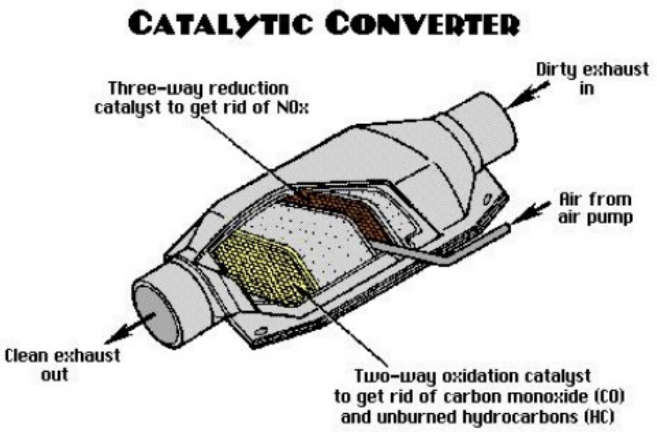
Pollutants Produced by a Car Engine
The main emissions of a car engine are: • Nitrogen gas (N2) - Air is 78-percent nitrogen gas, and most of this passes right through the car engine. • Carbon dioxide (CO2) - This is one product of combustion. The carbon in the fuel bonds with the oxygen in the air. • Water vapor (H2O) - This is another product of combustion. The hydrogen in the fuel bonds with the oxygen in the air
These emissions are mostly benign (although carbon dioxide emissions are believed to contribute to global warming). But because the combustion process is never perfect, some smaller amounts of more harmful emissions are also produced in car engines: • Carbon monoxide (CO) - a poisonous gas that is colorless and odorless • Hydrocarbons or volatile organic compounds (VOCs) - produced mostly from unburned fuel that evaporates Sunlight breaks these down to form oxidants, which react with oxides of nitrogen to cause ground level ozone (O₃), a major component of smog. • Nitrogen oxides (NO and NO₂, together called NOx) - contributes to smog and acid rain, and also causes irritation to human mucus membranes. These are the three main regulated emissions, and also the ones that catalytic converters are designed to reduce.

Slide 57
How Catalytic Converters Reduce Pollution
Most modern cars are equipped with three-way catalytic converters. "Three-way" refers to the three regulated emissions it helps to reduce─carbon monoxide, VOCs and NOx molecules. The converter uses two different types of catalysts, a reduction catalyst and an oxidation catalyst. Both types consist of a ceramic structure coated with a metal catalyst, usually platinum, rhodium and/or palladium. The idea is to create a structure that exposes the maximum surface area of catalyst to the exhaust stream, while also minimizing the amount of catalyst required (they are very expensive). There are two main types of structures used in catalytic converters -- honeycomb and ceramic beads. Most cars today use a honeycomb structure.
The Reduction Catalyst
The reduction catalyst is the first stage of the catalytic converter. It uses platinum and rhodium to help reduce the NOx emissions. When an NO or NO₂ molecule contacts the catalyst, the catalyst rips the nitrogen atom out of the molecule and holds on to it, freeing the oxygen in the form of O₂. The nitrogen atoms bond with other nitrogen atoms that are also stuck to the catalyst, forming N2. For example:
2NO → N₂ + O₂

Slide 58
The Oxidization Catalyst
The oxidation catalyst is the second stage of the catalytic converter. It reduces the unburned hydrocarbons and carbon monoxide by burning (oxidizing) them over a platinum and palladium catalyst. This catalyst aids the reaction of the CO and hydrocarbons with the remaining oxygen in the exhaust gas. For example: 2CO + O₂ → 2CO₂

